Slide 1

Data Visualization with Python

Slide 2
Objectives
Apply the knowledge learned to perform statistical analysis of data
Represent statistical data in the form of visualization
Implement by Python language
Lab - Data Visualization

Slide 3
Requirements
A survey was conducted to gauge audience interest in different data science topics, namely:
  Big Data (Spark / Hadoop)
  Data Analysis Statistics
  Data Journalism
  Data Visualization
  Deep Learning
  Machine Learning
Lab - Data Visualization

Slide 4
Requirements
The participants had three options for each topic:
  Very Interested
  Somewhat interested
  Not interested.
Total: 2,233 respondents completed the survey.
Lab - Data Visualization

Slide 5
Tasks
Use the artist layer of Matplotlib to replicate the bar chart below to visualize the percentage of the respondents' interest in the different data science topics surveyed.
Lab - Data Visualization

Slide 6
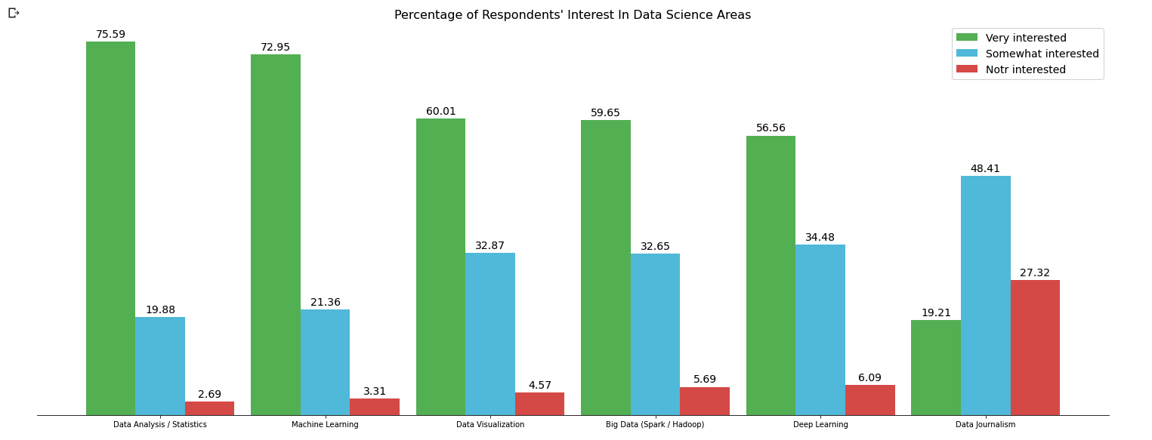
Expected Result
Lab - Data Visualization

Slide 7
Summary
Apply the knowledge learned to perform statistical analysis of data
Represent statistical data in the form of visualization
Implement by Python language
Lab - Data Visualization

Slide 8
Q & A
Lab - Data Visualization

